Slide 1
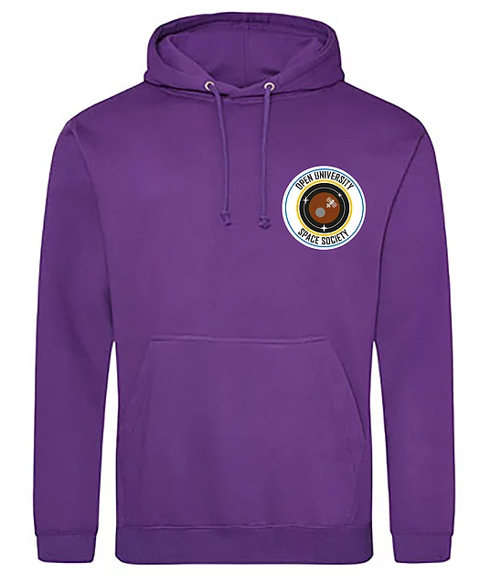
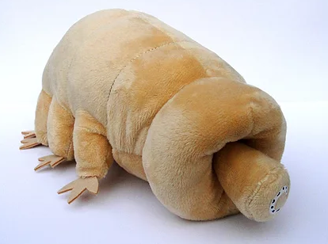
The OU Space Society are running four competitions for World Space Week 4th -10th October 2021 This years theme is Women in Space.
So get your pens, cameras and crafting kit at the ready. Choose the competition which best suits your creative side and good luck!
Writing competition – send us a original piece of work no more than 500 words for your chance to win a hoodie (size and colour to be chosen by winner)
Photo competition – show us your best space related photo for a chance to win a mug
Art/craft competition – get crafty and inspired and send us a photo of your creation for a chance to win a mission patch
Kids art/craft competition – we would love to see how creative your little ones can be.
Three lucky winners will win a society mascot Captain Tardi
(one winner will be chosen from each age category) Age categories 4-6 , 7-10 and 11-16
Parents/carers please feel free to give us a description of the creations and tell us which age category you are entering in.
Enter by emailing: ouspacesociety@outlook.com
All competitions close Thursday 7th October 2021 at midnight All entries will be reviewed by the Space Society committee and winners will be notified by email on Sunday 10th October 2021

